Slide 1
ClubLife
Sasha Hedges, Jonathan Merklin, Brandon Poole, Zach Babka

Slide 2





Problem
I am a member of multiple clubs
I want to keep these organized
I want to get updates for my clubs
Notes:
Sasha

Slide 3



Problem
I am a club leader
I want to contact my club members
I want to create events
I want to post to social media
Notes:
Sasha

Slide 4
Scope of System
Student:
Create/Edit own profile
Find a club
View other profiles
Contact a club
Find an event
Request to join club
Officer:
Approve potential members
Create events
Post to club page
Post to social media
Club Leader:
- Edit club information (i.e. with increased privilege)
Notes:
Zach

Slide 5
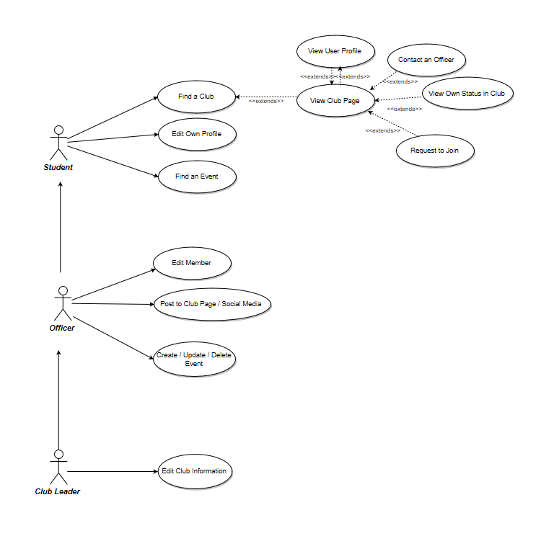
Use Case Diagrams - Big Picture
Notes:
sasha

Slide 6
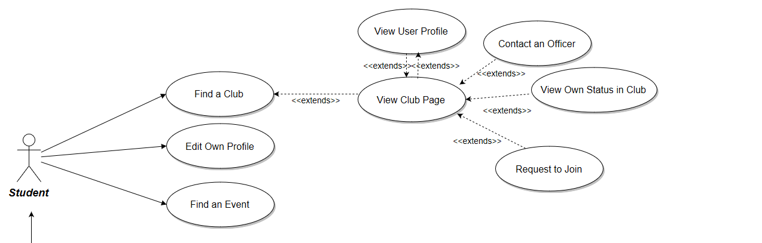
Use Case Diagrams - Student
Notes:
Sasha

Slide 7
Use Case Diagrams - Officer
Notes:
Sasha

Slide 8
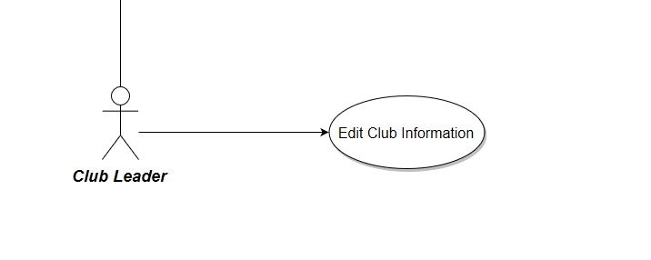
Use Case Diagram - Club Leader
Notes:
Sasha

Slide 9
Class Diagram
Notes:
Jonathan

Slide 10
Activity Diagram: Find a Club
Notes:
Jonathan

Slide 11
Activity Diagram: Find a Club
Notes:
jonathan

Slide 12
Activity Diagram: Find an Event
Notes:
Jonathan

Slide 13
Activity Diagram: Edit Member
Notes:
Zach

Slide 14
Activity Diagram:
Make a Club Post
Notes:
Brandon

Slide 15
Priority
Basic Features:
Students can join clubs, subscribe to club feeds, and create/update their profile
Club leaders can post to the club, create events, and track members’ status
Advanced Features:
Students can search for clubs using advanced filters such as meeting times, type of club, etc.
Clubs can contact other clubs to create co-hosted events
Future Features:
Students can submit suggestions to club officers
Club officers can track club finances within application
Notes:
Brandon

Slide 16
Potential Risks
Low time allotted to complete before graduation
Rome wasn’t built in a day, and the builders also weren’t simultaneously building Athens and Constantinople
Especially for first-time developers of the platform
Bugs could slow progress
Low adoption rate limits user experience
Security concerns of/relating to storing some user info
e.g. officer contact information
November 2016 Election
Notes:
Zach

Slide 17
Summary of Project
Project Vision:
Develop a cross-platform application that impacts how students interact with their clubs and organizations
Project Goals:
(Obvious, priority #1) Get a finished product out the door with as much functionality as possible given the time frame for development.
Reach out to clubs/students and get them to adopt ClubLife
Project Concerns:
Mostly covered in aforementioned potential risks
Mostly worried about time constraints
Issues with existing CollegiateLink infrastructure
Notes:
Brandon

Slide 18

Questions?
Notes:
Brandon

